Slide 1
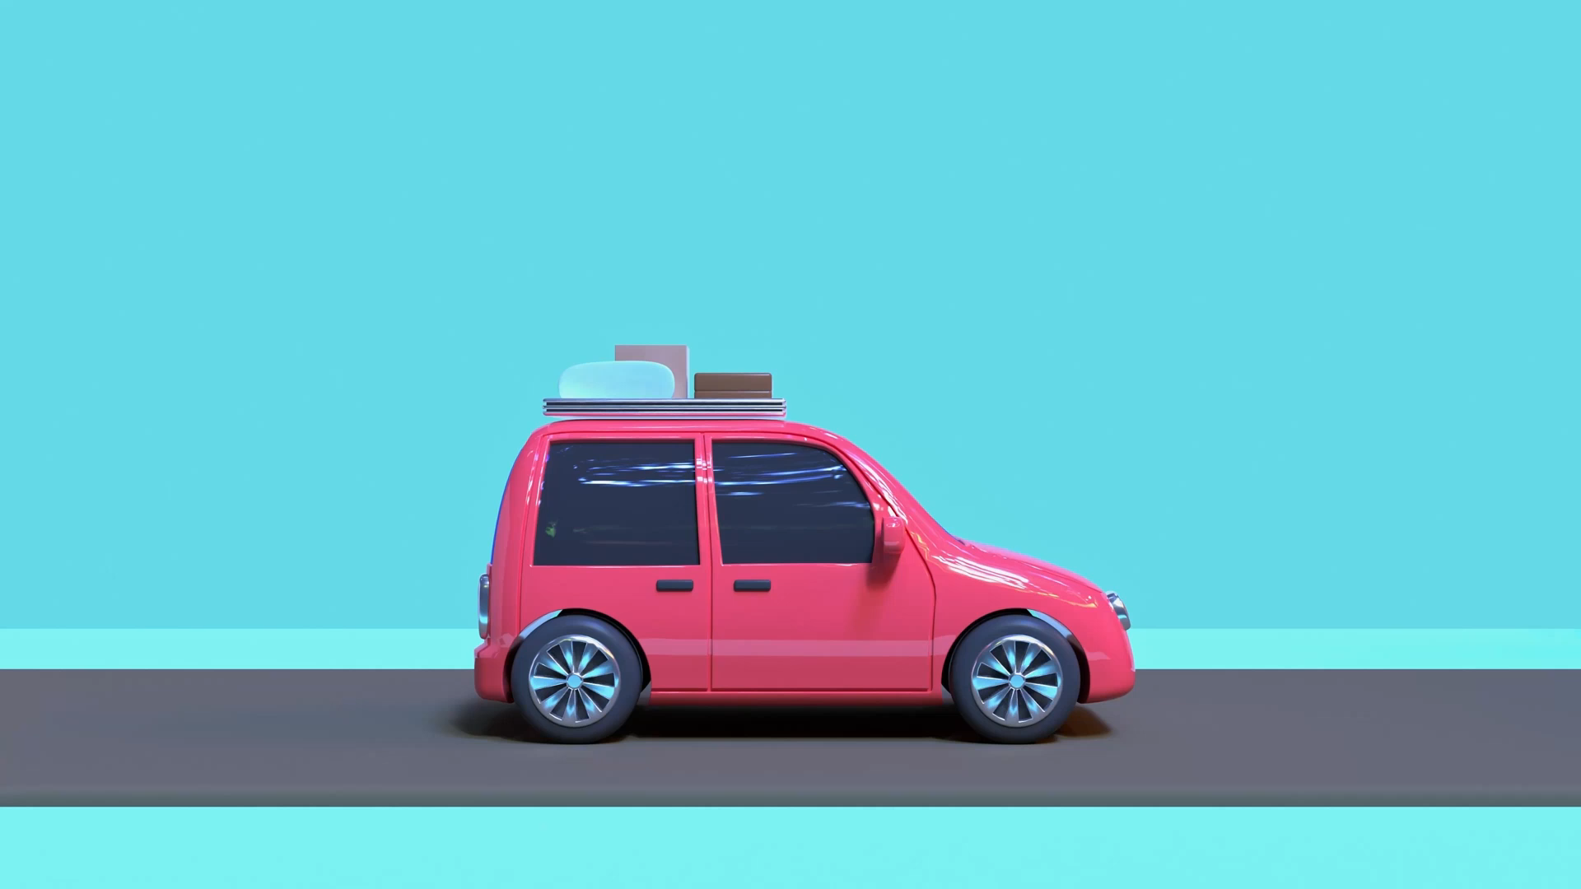
A Short Ride on the Digitalization Machine

Slide 2

The story so far…

Slide 3
1996 – The web arrives…
1998 – Virtual Learning Environments
1996 – The web arrives…
2004 – Mass adoption and Learning Platforms

